Slide 1
VISUAL C#.NET session 13
Instructor: Edwin oduor

Slide 2
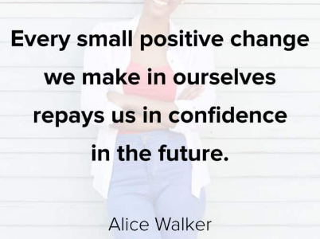
Quote of the day

Slide 3
Lesson objectives
OOP Principles
Class
Object
Illustration a class and Object
Pillars of OOP
Abstraction
Real Life Examples of Abstraction
Encapsulation
Inheritance
Types of Inheritance
Polymorphism
Access Modifiers

Slide 4
Lesson pre-requisites
In order to take full advantage of this section you need to have the following;
Computer with Visual Studio Installed.
Stable Network Connection.

Slide 5
Training methods and extra readings
TRAINING METHODS FOR THIS LESSON
EXTRA READINGS
Lecturing Method – This is the main method of training to be adopted in this lesson with illustrations and practical coding examples.
Discussion Method - This method will be adopted periodically whereby learning will be derived principally from the students brainstorming together, rather than from the trainer. Three main types of discussions will be used:
Directed discussion
Developmental discussion
Problem-Solving discussion
Home and Learn C#

Slide 6
OBJECT ORIENTED PROGRAMMING (OOP) PRACTICAL SESSION

Slide 7
CREATING A CLASS

Slide 8
public class nameOfClass
{
}
A class has properties and methods besides these two a class also has a constructor and a destructor, The constructor is used to initialize the fields or the properties in the class, while the destructor is used to clean up the resources. In C# there is no need to create the destructors as it is going to do that automatically. Let’s take a look at a simple class so that we understand how to go about it.

Slide 9
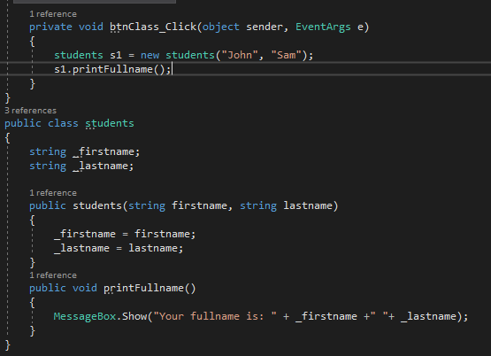
CREATING A CLASS
4
1
2
3

Slide 10
Let’s understand the code in previous slide
Label number one a class is created with the name students
Label number two a constructor is created remember a constructor takes the name of the class, this constructor is going to initialize the properties in the class
A method has been created printFullname that is going to print the fullname of a student.
An object is being created and the created object is used to access the methods inside a class, in this case the object is used to access the printFullname method.

Slide 11
In a nutshell a class has properties, constructors and methods.
NB: it’s not mandatory to provide the constructor, can still work without the constructor. Though when creating the object there will be no need of providing First name and Last name, because this one’s was being provided because of the constructor.

Slide 12
Inheritance
We have already talked about inheritance theoretically; we need to know how to inherit from the base class. Will continue with the example used in the previous page. We already have a class by the name students, students is the base class. When creating a class, it should be outside another class but inside a namespace (Used to logically arrange classes) Some modification of the class will be done, first the properties inside the class will set them as public so as to use them to demonstrate a few things, but you should know that fields in the class should be set as private, when this is done then the fields in the class are actually protected from being accessed differently outside the class. (Will talk more about this as we proceed)

Slide 13
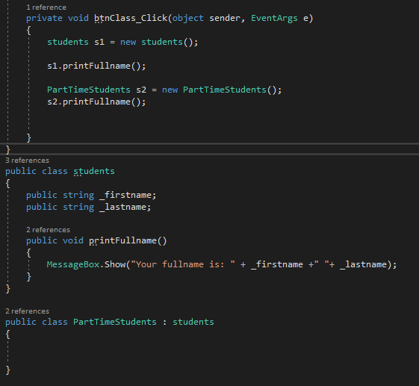
Inheritance cont..
From the code on the left another class has been created called PartTimeStudents (Derived Class) inheriting from the base class (students), because of inheritance the derived class can access the method inside the students class and also the properties inside the base class since they are public.

Slide 14
Inheritance cont..
A derived class can also have its own properties and methods and also inherit the properties and methods of the base class.
Why use Inheritance
Inheritance allows code re-use
Code re-use will help to avoid errors and reduce time when writing code.
Enhance application performance

Slide 15
exercise

Slide 16
Create a class that is going to implement the other two types of inheritance discussed earlier, that is Hierarchical and multi-level inheritance. The base class should have at least two properties and one method, create an object from each of the derived class that is going to access the properties and methods that are in the base class.
Create a base class called Employees, the base class should have properties for now set the properties as public (as we proceed, we will be able to know why it’s not advisable to set them as public) these are properties that should be used, First name, Last name, Department. Create two more classes Full time employees and Part time employees. Full time employees should have a method that is calculating their salaries, to calculate their salary you need to know the hours worked and rate, the min hours that they can work is 7 hours and the max is 9 hours at a rate of 600 per hour. The part time employees can work for a max of 4 hours and min of 2 hours at a rate of 350. The methods for respective classes should display the properties in the base class when calculating the salaries for the employees.

Slide 17
Access modifiers

Slide 18
Public – Public means that the properties, methods that uses public can be accessed from anywhere within the project.
Private – When the properties, methods or a class has a key word private then it means that that property can only be accessed within the class and not outside the class, for tit to be accessed outside the class then we need to use what is known as properties in C# or getters and setters to access it. This is the preferred way of creating properties in a class, because with this the programmer has total control of what is happening.
Protected – Protected key word means that the properties are accessible inside the class and all the classes that derive from it.

Slide 19
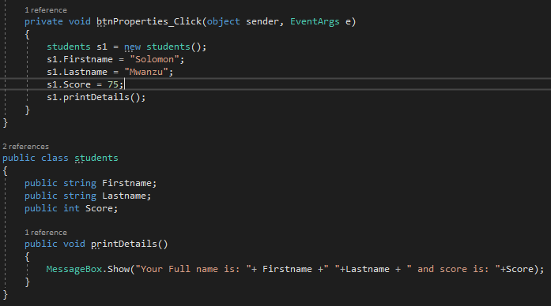

Slide 20
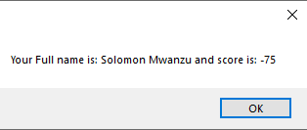
From the previous code a class has been created, the class has 3 properties and one method. The properties and method are accessed in the button because they are all public. The fact that the properties are public one can enter anything that they want and the system will accept what has been entered. For instance, let’s say our field score does not accept negative numbers but the way it is at the moment one can enter a negative number. If a negative number is entered it’s still going to execute without any problems. From the fig below a negative value has been entered as the score and the system goes ahead and print the value in a message box. From this example we can see that when a field is set as public then one does not have total control. The field will be set a private field and see what happens.

